Slide 1
Introduction to Neural Network
By
Varun Deshmukh
Assistant Professor,
Department of Computer Engineering,
MPSTME, Shirpur Campus

Slide 2
Introduction to Neural Network
Neural Networks
Biological Neuron
Models of ANN
Types of Learning
Different Activation functions
McCulloch and Pitts model of neuron
Neural processing
Neural network learning rules

Slide 3
Neural Networks
A neural network is a processing unit, either an algorithm or an actual hardware, whose design was inspired by the design and functioning of animal brains and components.
It is also known as Artificial Neural Networks or Neural Net.
The neural networks have the ability to learn by example, which makes them very flexible and powerful.
For neural networks, there is no need to devise an algorithm to perform a specific task, that is, there is no need to understand the internal mechanism of that task.
These networks are also well suited for real time systems because of their fast response and computational times which are because of their parallel architecture.

Slide 4
Advantages of Neural Networks
Neural networks, with their remarkable ability to derive meaning from complicated or imprecise data, could be used to extract patterns and detect trends that are too complex to be noticed by either humans or other computer techniques.
A trained neural network could be thought of as an “expert” in a particular category of information it has been given to analyze.
This expert could be used to provide projections in new situations of interest and answer “what if” questions.
Other advantages of working with an ANN include:
Adaptive learning
Self organization
Real time operation
Fault tolerance via redundant information coding

Slide 5
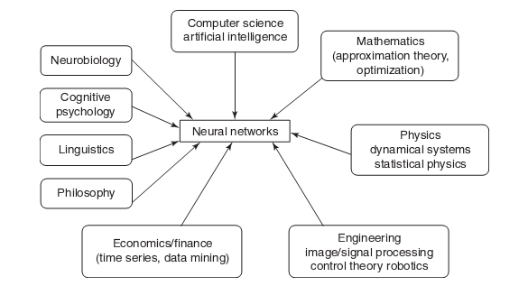
Multidisciplinary view of Neural Networks

Slide 6
Application scope of Neural Networks
The neural network have good scope of being used in the following areas
Air traffic control could be automated with the location, altitude, direction and speed of each radar blip taken as input to the network.
Animal behavior, predator/ prey relationships and population cycles may be suitable for analysis by neural networks.
Appraisal and valuation of property, buildings, automobiles, machinery, etc. should be an easy task for a neural network.
Betting on horse races, stock markets, sporting events, etc. could be based on neural network predictions.
Criminal sentencing could be predicted using a large sample of crime details as input and the resulting sentences as output.
Complex physical and chemical processes that may involve the interaction of numerous mathematical formulas could be modeled heuristically using a neural network.
Echo patterns from sonar, radar, seismic and magnetic instruments could be used to predict their targets.

Slide 7
Application scope of Neural Networks
Data mining, cleaning and validation could be achieved by determining which records suspiciously diverge from the pattern of their peers.
Direct mail advertisers could use neural network analysis of their databases to decide which customer should be targeted, and avoid wasting money on unlikely targets.
Economic modeling based on neural networks should be more realistic than older models based on classical statistics.
Employee hiring could be optimized if the neural networks were able to predict which job applicant would show the best job performance.
Expert consultants could package their intuitive expertise into a neural network to automate their services.
Fraud detection regarding credit cards, insurance or taxes could be automated using a neural network analysis of past incidents.
Medical diagnosis is an ideal application for neural networks.

Slide 8
Application scope of Neural Networks
Hand writing and typewriting could be recognized by imposing a grid over the writing, then each square of the grid becomes an input to the neural network.
Lake water levels could be predicted based upon precipitation patterns and river/dam flows.
Machinery control could be automated by capturing the actions of experienced machine operators into a neural network.
Medical research relies heavily on classical statistics to analyse research data. Perhaps a NN should be included in the researchers tool kit.
Music composition has been tried using NN. The n/w is trained to recognize patterns in the pitch and tempo of certain music, and then the n/w writes its own music.
Photos and fingerprints could be recognized by imposing a fine grid over the photo. Each square of the grid becomes an input to the NN.

Slide 9
Application scope of Neural Networks
Recipes and chemical formulations could be optimized based on the predicted outcome of a formula change.
Retail inventories could be optimized by predicting demand based on past patterns.
River water levels could be predicted based on upstream reports, and time and location of each report.
Scheduling of buses, airplanes and elevators could be optimized by predicting demands.
Staff scheduling requirements for restaurants, retail stores, police stations, banks etc. could be predicted based on the customer flow, day of week, paydays, holidays, weather, season, etc.
Strategies for games, business and war can be captured by analyzing the expert player’s response to given stimuli. For example, a football coach must decide whether to kick, pass or run on the last down. The inputs for this decision include score, time, field location, yards to first down etc.

Slide 10
Application scope of Neural Networks
Traffic flows could be predicted so that signal timing could be optimized. The neural network could recognize “a weekday morning rush hour during a school holiday” or “a typical winter Sunday morning.
Voice recognition could be obtained by analyzing the audio oscilloscope pattern, much like a stock market graph.
Weather prediction may be possible. Inputs would include weather reports from surrounding areas. Output(s) would be the future weather in specific areas based on the input information. Effects such as ocean currents and jet streams could be included.

Slide 11
Artificial Neural Networks
An artificial neural network (ANN) may be defined as an information processing model that is inspired by the way biological nervous systems, such as the brain, process information.
This model tries to replicate only the most basic functions of the brain.
The key element of ANN is the novel structure of its information processing system.
An ANN is composed of a large number of highly interconnected processing elements working simultaneously to solve specific problems.
ANN, like people, learn by example.
An ANN is configured for a specific application, such as pattern recognition of data classification through a learning process.
In biological systems, learning involves adjustments to the synaptic connections that exist between neurons.

Slide 12
Artificial Neural Networks
An artificial neural network (ANN) possess large number of highly interconnected processing elements called nodes or units or neurons, which usually operate in parallel and are configured in regular architectures.
Each neuron is connected with the other by a connection link.
Each connection link is associated with weights which contain information about the input signal.
This information is used by the neuron net to solve a particular problem.
ANN’s collective behavior is characterized by their ability to learn, recall and generalize training patterns or data similar to that of a human brain.
They have the capability to model networks of original neurons as found in the brain.
Thus, the ANN processing elements are called neurons or artificial neurons.

Slide 13
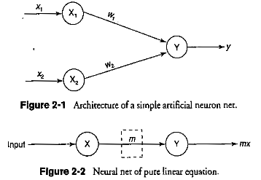
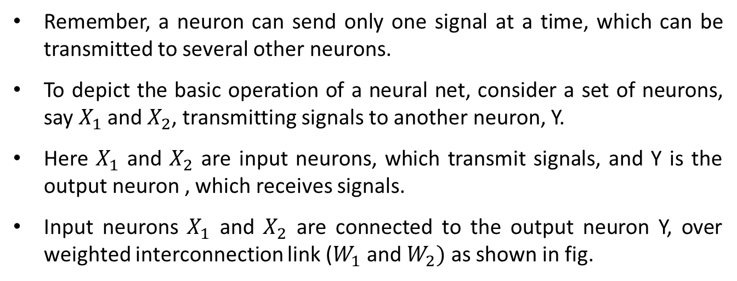
Artificial Neural Networks
It should be noted that each neuron has an internal state of its own.
This internal state is called the activation or activity level of neuron, which is the function of the inputs the neuron receives.
The activation signal of a neuron is transmitted to other neurons.
Remember, a neuron can send only one signal at a time, which can be transmitted to several other neurons.
To depict the basic operation of a neural net, consider a set of neurons, say $X_{1}$ and $X_{2}$, transmitting signals to another neuron, Y.
Here $X_{1}$ and $X_{2}$ are input neurons, which transmit signals, and Y is the output neuron , which receives signals.
Input neurons $X_{1}$ and $X_{2}$ are connected to the output neuron Y, over weighted interconnection link ($W_{1}$ and $W_{2})$ as shown in fig.

Slide 14
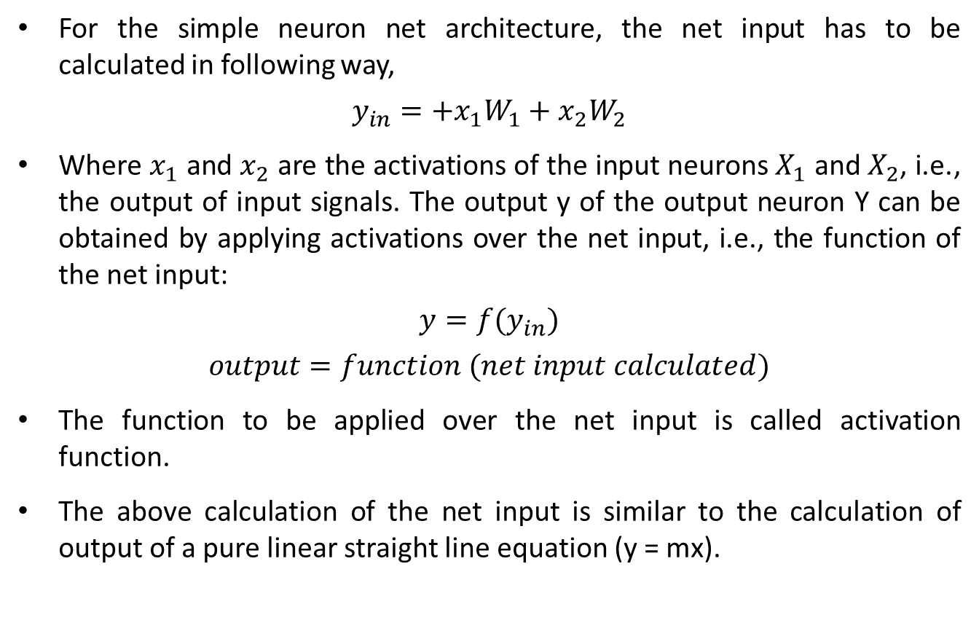
Artificial Neural Networks
For the simple neuron net architecture, the net input has to be calculated in following way,
$$y_{in}=+x_{1}W_{1}+x_{2}W_{2}$$
Where $x_{1}$ and $x_{2}$ are the activations of the input neurons $X_{1}$ and $X_{2}$, i.e., the output of input signals. The output y of the output neuron Y can be obtained by applying activations over the net input, i.e., the function of the net input:
$$y=f(y_{in})$$
$$output=function (net input calculated)$$
The function to be applied over the net input is called activation function.
The above calculation of the net input is similar to the calculation of output of a pure linear straight line equation (y = mx).

Slide 15
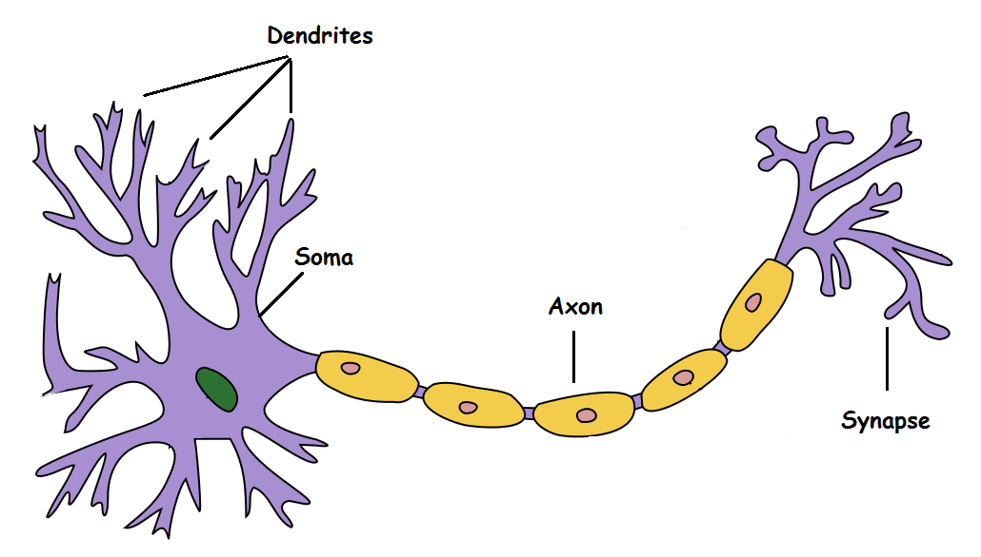
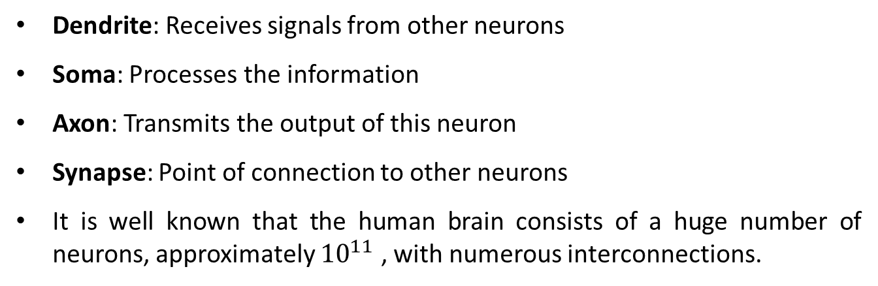
Biological Neural Networks
Dendrite: Receives signals from other neurons
Soma: Processes the information
Axon: Transmits the output of this neuron
Synapse: Point of connection to other neurons
It is well known that the human brain consists of a huge number of neurons, approximately ${10}^{11}$ , with numerous interconnections.

Slide 16
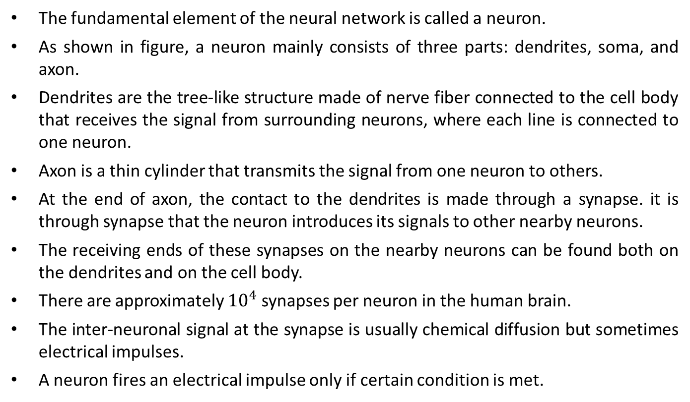
Biological Neural Networks
The fundamental element of the neural network is called a neuron.
As shown in figure, a neuron mainly consists of three parts: dendrites, soma, and axon.
Dendrites are the tree-like structure made of nerve fiber connected to the cell body that receives the signal from surrounding neurons, where each line is connected to one neuron.
Axon is a thin cylinder that transmits the signal from one neuron to others.
At the end of axon, the contact to the dendrites is made through a synapse. it is through synapse that the neuron introduces its signals to other nearby neurons.
The receiving ends of these synapses on the nearby neurons can be found both on the dendrites and on the cell body.
There are approximately ${10}^{4}$ synapses per neuron in the human brain.
The inter-neuronal signal at the synapse is usually chemical diffusion but sometimes electrical impulses.
A neuron fires an electrical impulse only if certain condition is met.

Slide 17
Biological Neural Networks
Electric impulses are passed between the synapse and the dendrites.
This type of signal transmission involves a chemical process in which specific transmitter substances are released from the sending side of the junction.
This results in increase or decrease in the electric potential inside the body of the receiving cell.
If the electric potential reaches a threshold then the receiving cell fires and a pulse or action potential of fixed strength and duration is sent out through the axon to the synaptic junctions of the other cells.
After firing, a cell has to wait for a period of time called refractory period before it can fire again.
The synapses are said to be inhibitory if they let passing impulses hinder the firing of receiving cell or excitatory if they let passing impulses cause the firing of the receiving cell.
The condition of causing firing is that the excitatory signal should exceed the inhibitory signal by a certain amount in a short period of time, called the period of latent summation.
As we assign a weight to each incoming impulse signal, the excitatory signal has positive weight and the inhibitory signal has negative weight.

Slide 18
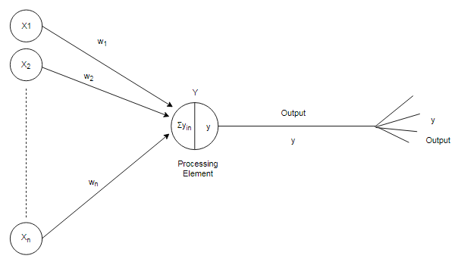
Biological Neural Networks
Terminology relationships between biological and artificial neuron
Biological Neuron | Artificial Neuron
Soma | Neuron
Synapse | Weights or interconnections
Dendrites | Net input
Axon | Output

Slide 19
Models of Artificial Neural Networks
The neurons should be visualized for their arrangements in layers.
An ANN consists of a set of highly inter­connected processing elements (neurons) such that each processing element output is found to be connected through weights to the other processing elements or to itself, delay lead and lag-free connections are allowed.
Hence, the arrangements of these processing elements and the geometry of their interconnections are essential for an ANN.
The point where the connection originates and terminates should be noted, and the function of each processing element in an ANN should be specified.
Besides the simple neuron, there exist several other types of neural network connections.
The arrangement of neurons form layers and the connection pattern formed within and between layers is called the network architecture.

Slide 20
Models of Artificial Neural Networks
There exist five basic types of neuron connection architectures. They are
Single layer feed forward network
Multilayer feed forward network
Single node with its own feedback
Single layer recurrent network
Multilayer recurrent network
Basically, neural nets are classified into single-layer or multilayer neural nets. A layer is formed by taking a processing element and combining it with other processing elements.

Slide 21
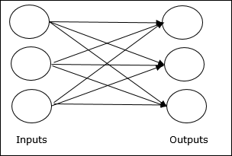
Single layer feed forward network
Practically, a layer implies a stage, going stage by stage, i.e., the input stage and the output stage are linked with each other.
These linked interconnections lead to the formation of various network architectures. When a layer of the processing nodes is formed, the inputs can be connected to these nodes with various weights, resulting into series of outputs one per node.
Thus, a single layer feed forward network is formed.
The concept is of feedforward ANN having only one weighted layer. In other words, we can say the input layer is fully connected to the output layer.

Slide 22
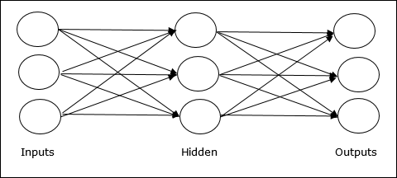
Multilayer feed forward network
A multilayer feed-forward network is formed by the interconnection of several layers.
The input layer is that which receives the input and this layer has no function except buffering the input signal.
The output layer generates the output of the network. Any layer that is formed between the input and output layers is called hidden layer.
This hidden layer is internal to the network and has no direct contact with the external environment. It should be noted that there may be zero to several hidden layers in an ANN.
More the number of the hidden layers, more is the complexity of the network. This may, however, provide an efficient output response.
In case of a fully connected network every output from one layer is connected to each and every node in the next layer.

Slide 23
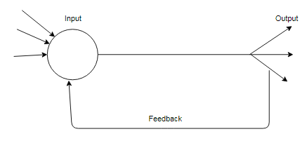
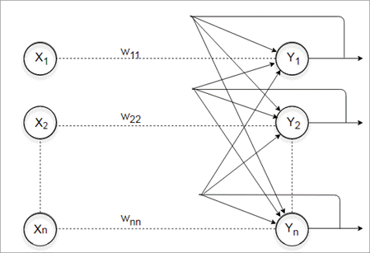
Single node with its own feedback & Single layer recurrent network
A network is said to be a feed-forward network if no neuron in the output layer is an input to a node in the same layer or in the preceding layer.
On the other hand, when outputs can be directed back as inputs to same or preceding layer nodes then it results in the formation of feedback networks.
If the feedback of output of the processing elements is directed back as input to the processing elements in the same layer then it is called lateral feedback.
Recurrent networks are feedback networks with close loop.
Figure above shows a simple recurrent neural network having a single neuron with feedback to itself.
Figure below shows a single layer network with a feedback connection in which a processing element's output can be directed back to the processing element itself or to the other processing element or to both.

Slide 24
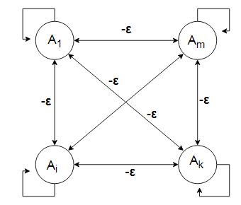
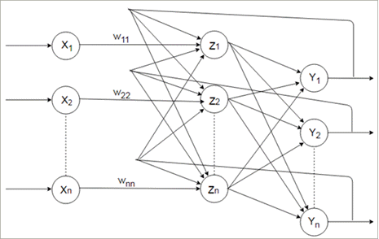
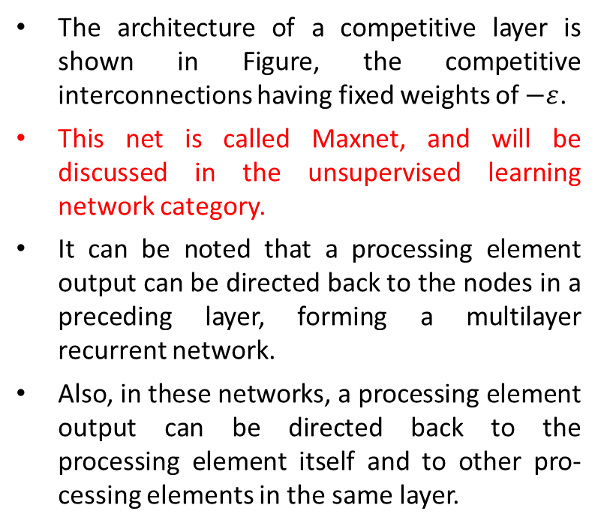
Competitive network & Multilayer recurrent network
The architecture of a competitive layer is shown in Figure, the competitive interconnections having fixed weights of $−ε$.
This net is called Maxnet, and will be discussed in the unsupervised learning network category.
It can be noted that a processing element output can be directed back to the nodes in a preceding layer, forming a multilayer recurrent network.
Also, in these networks, a processing element output can be directed back to the processing element itself and to other pro­cessing elements in the same layer.

Slide 25
Types of Learning
The main property of an ANN is its capability to learn.
Learning or training is a process by means of which a neural network adapts itself to a stimulus by making proper adjustments resulting in the production of desired response.
Broadly, there are two kinds of learning in ANNs:
Parameter learning: it updates the connecting weights in a neural net.
Structure learning: It focuses on the change in network structure (which includes the number of processing elements as well as their connection types).
The above two types of learning can be performed simultaneously or separately.
Apart from these two categories of learning, the learning in an ANN can be generally classified into three categories as: supervised learning; unsupervised learning; reinforcement learning.

Slide 26
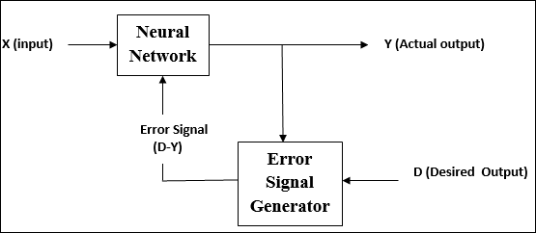
Supervised Learning
As the name suggests, this type of learning is done under the supervision of a teacher. This learning process is dependent.
During the training of ANN under supervised learning, the input vector is presented to the network, which will give an output vector. This output vector is compared with the desired output vector. An error signal is generated, if there is a difference between the actual output and the desired output vector. On the basis of this error signal, the weights are adjusted until the actual output is matched with the desired output.

Slide 27
Supervised Learning
The learning here is performed with the help of a teacher. Let us take the example of the learning process of a small child.
The child doesn't know how to read/write. He/she is being taught by the parents at home and by the teacher in school.
The children are trained and molded to recognize the alphabets, numerals, etc.
Their each and every action is supervised by a teacher. Actually, a child works on the basis of the output that he/she has to produce. All these real-time events involve supervised learning methodology.
In this type of training a supervisor or teacher is required for error minimization. Hence the network trained by this method is said to be using supervised training methodology.
In supervised learning it is assumed that the correct “target” output values are known for each input pattern.

Slide 28
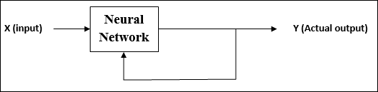
Unsupervised Learning
As the name suggests, this type of learning is done without the supervision of a teacher. This learning process is independent.
During the training of ANN under unsupervised learning, the input vectors of similar type are combined to form clusters. When a new input pattern is applied, then the neural network gives an output response indicating the class to which the input pattern belongs.
There is no feedback from the environment as to what should be the desired output and if it is correct or incorrect. Hence, in this type of learning, the network itself must discover the patterns and features from the input data, and the relation for the input data over the output.

Slide 29
Unsupervised Learning
Consider the learning process of a tadpole, it learns by itself, that is, a child fish learns to swim by itself, it is not taught by its mother.
Thus, its learning process is independent and is nor supervised by a teacher.
From Figure it is clear that there is no feedback from the environment to inform what the outputs should be or whether the outputs are correct.
In this case, the network must itself discover patterns regularities, features or categories from the input data and relations for the input data over the output.
While discovering all these features, the network undergoes change in its parameters.
This process is called self organizing in which exact clusters will be formed by discovering similarities and dissimilarities among the objects.

Slide 30
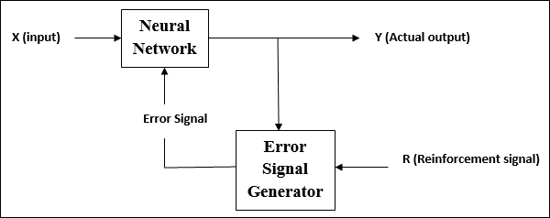
Reinforcement Learning
As the name suggests, this type of learning is used to reinforce or strengthen the network over some critic information. This learning process is similar to supervised learning, however we might have very less information.
During the training of network under reinforcement learning, the network receives some feedback from the environment. This makes it somewhat similar to supervised learning. However, the feedback obtained here is evaluative not instructive, which means there is no teacher as in supervised learning. After receiving the feedback, the network performs adjustments of the weights to get better critic information in future.

Slide 31
Reinforcement Learning
This learning process is similar to supervised learning. In the case of supervised learning, the correct target output values are known for each input pattern. But, in some cases, less information might be available.
For example, the network might be told that its actual output is only "50% correct" or so. Thus, here only critic information is available, not the exact information.
The block diagram of reinforcement learning shows it is form of supervised learning as the network receives some feedback from its environment.
However, the feedback obtained here is only evaluative and not instructive.
The external reinforcement signals are processed in the critic signal generator, and the obtained critic signals are sent to the ANN for adjustment of weights properly so as to get better critic feedback in future.
The reinforcement learning is also called learning with a critic as opposed to learning with a teacher, which indicates supervised learning.

Slide 32
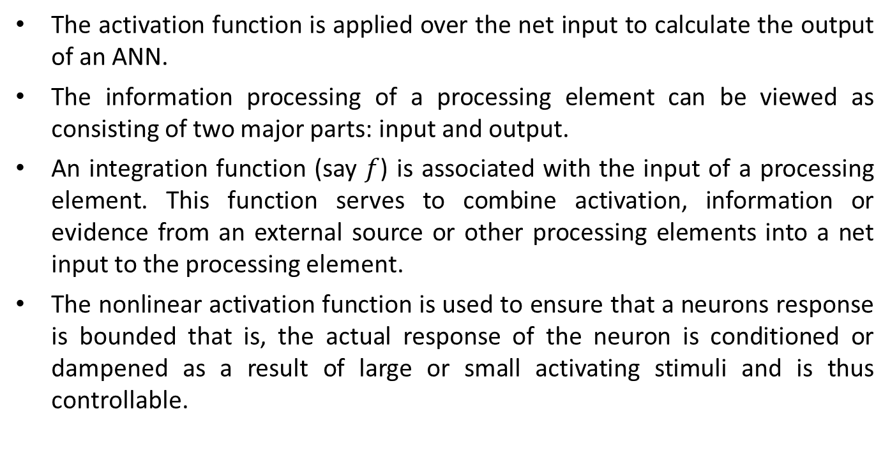
Activation Functions
The activation function is applied over the net input to calculate the output of an ANN.
The information processing of a processing element can be viewed as consisting of two major parts: input and output.
An integration function (say $f$) is associated with the input of a processing element. This function serves to combine activation, information or evidence from an external source or other processing elements into a net input to the processing element.
The nonlinear activation function is used to ensure that a neurons response is bounded that is, the actual response of the neuron is conditioned or dampened as a result of large or small activating stimuli and is thus controllable.

Slide 33
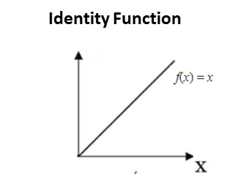
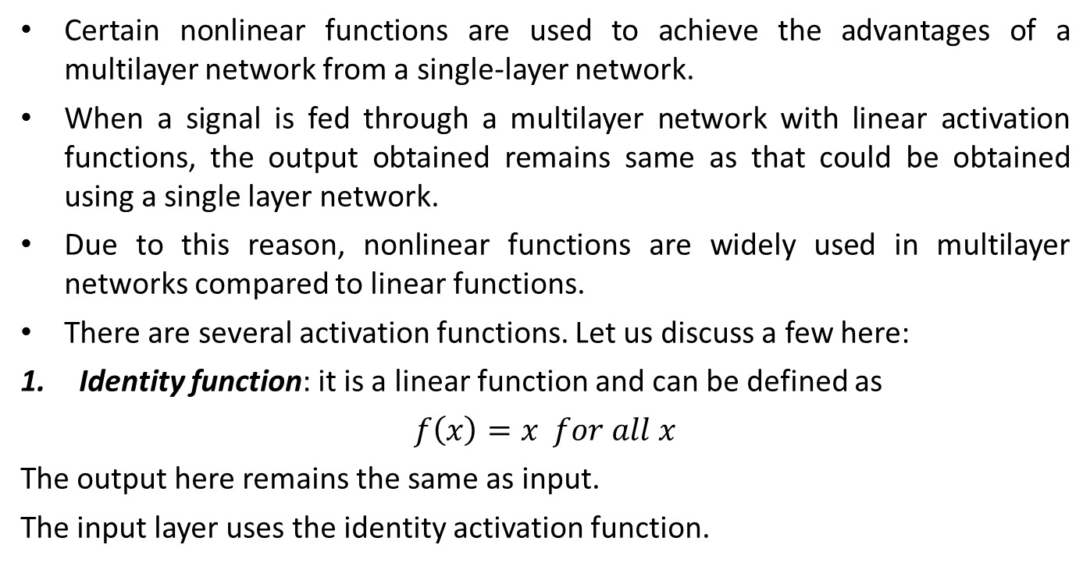
Activation Functions
Certain nonlinear functions are used to achieve the advantages of a multilayer network from a single-layer network.
When a signal is fed through a multilayer network with linear activation functions, the output obtained remains same as that could be obtained using a single layer network.
Due to this reason, nonlinear functions are widely used in multilayer networks compared to linear functions.
There are several activation functions. Let us discuss a few here:
Identity function: it is a linear function and can be defined as
$f\left(x\right)=x for all x$
The output here remains the same as input.
The input layer uses the identity activation function.

Slide 34
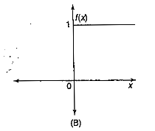
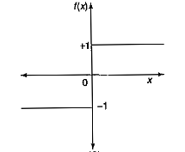
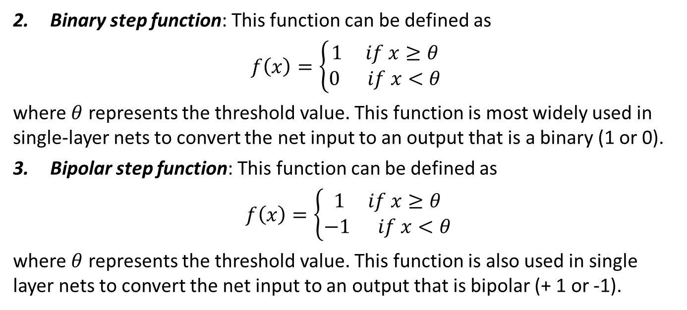
Activation Functions
Binary step function: This function can be defined as
$f\left(x\right)=\left\{\begin{matrix}1 if x≥θ \\ 0 if x<θ\end{matrix}\right.$
where $θ$ represents the threshold value. This function is most widely used in single-layer nets to convert the net input to an output that is a binary (1 or 0).
Bipolar step function: This function can be defined as
$f\left(x\right)=\left\{\begin{matrix}1 if x≥θ \\ −1 if x<θ\end{matrix}\right.$
where $θ$ represents the threshold value. This function is also used in single layer nets to convert the net input to an output that is bipolar (+ 1 or -1).

Slide 35
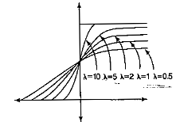
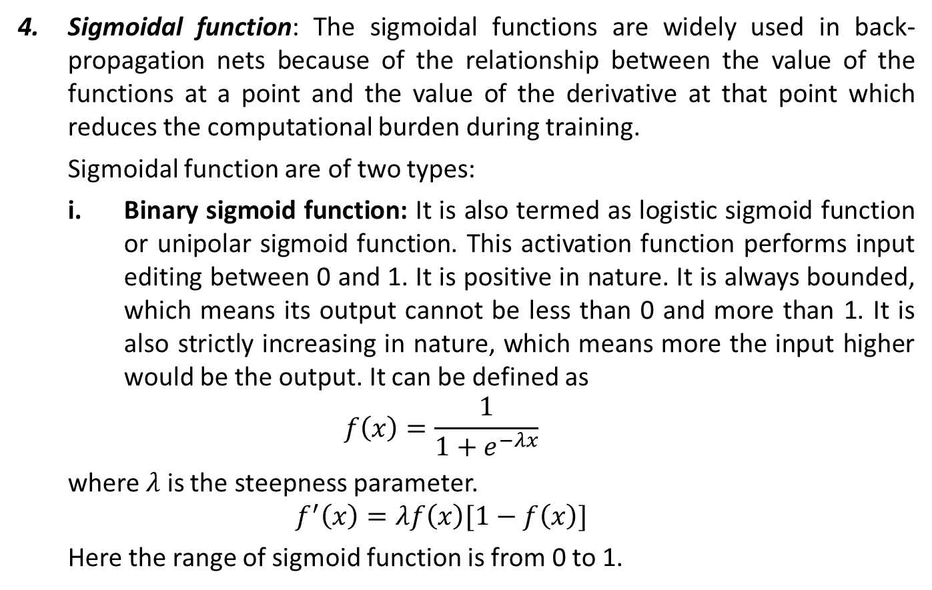
Activation Functions
Sigmoidal function: The sigmoidal functions are widely used in back-propagation nets because of the relationship between the value of the functions at a point and the value of the derivative at that point which reduces the computational burden during training.
Sigmoidal function are of two types:
Binary sigmoid function: It is also termed as logistic sigmoid function or unipolar sigmoid function. This activation function performs input editing between 0 and 1. It is positive in nature. It is always bounded, which means its output cannot be less than 0 and more than 1. It is also strictly increasing in nature, which means more the input higher would be the output. It can be defined as
$$f\left(x\right)=\frac{1}{1+e^{−λx}}$$
where $λ$ is the steepness parameter.
$$f^{′}\left(x\right)=λf\left(x\right)[1−f\left(x\right)]$$
Here the range of sigmoid function is from 0 to 1.

Slide 36
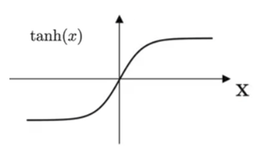
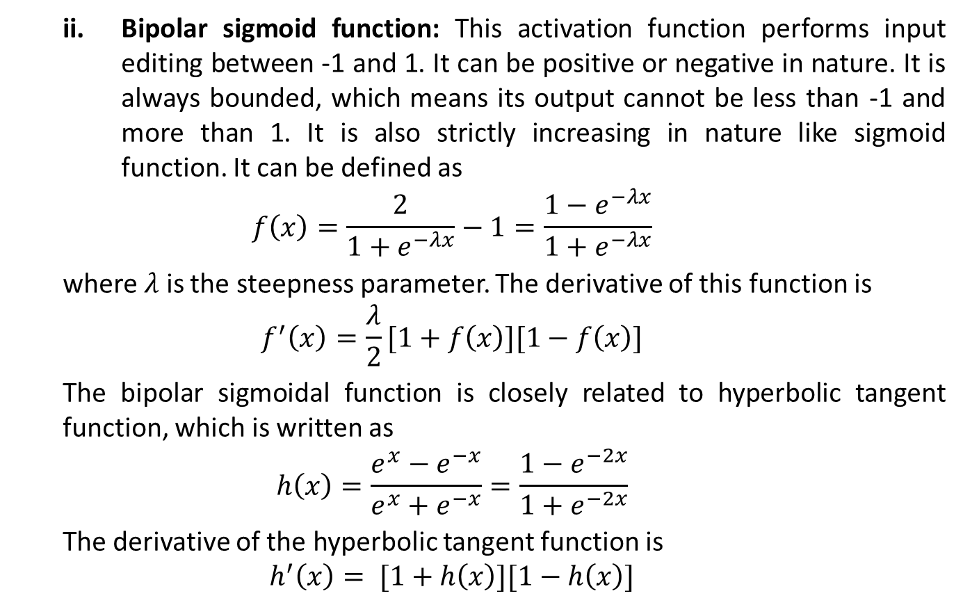
Activation Functions
Bipolar sigmoid function: This activation function performs input editing between -1 and 1. It can be positive or negative in nature. It is always bounded, which means its output cannot be less than -1 and more than 1. It is also strictly increasing in nature like sigmoid function. It can be defined as
$$f\left(x\right)=\frac{2}{1+e^{−λx}}−1=\frac{1−e^{−λx}}{1+e^{−λx}}$$
where $λ$ is the steepness parameter. The derivative of this function is
$$f^{′}\left(x\right)=\frac{λ}{2}[1+f\left(x\right)][1−f\left(x\right)]$$
The bipolar sigmoidal function is closely related to hyperbolic tangent function, which is written as
$$h\left(x\right)=\frac{e^{x}−e^{−x}}{e^{x}+e^{−x}}=\frac{1−e^{−2x}}{1+e^{−2x}}$$
The derivative of the hyperbolic tangent function is
$$h^{′}\left(x\right)= [1+h\left(x\right)][1−h\left(x\right)]$$

Slide 37
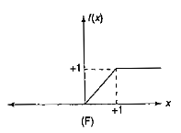
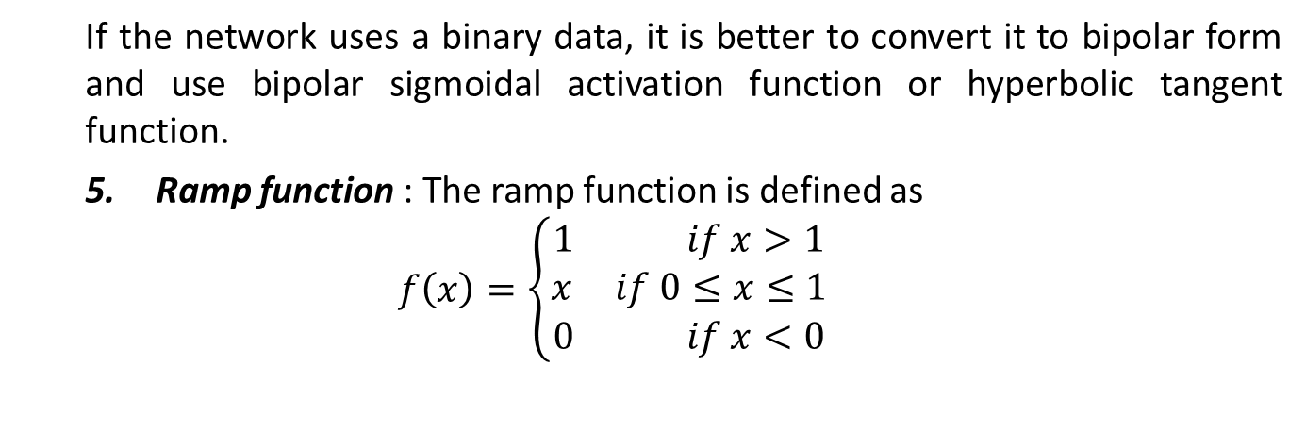
Activation Functions
If the network uses a binary data, it is better to convert it to bipolar form and use bipolar sigmoidal activation function or hyperbolic tangent function.
Ramp function : The ramp function is defined as
$$f\left(x\right)=\left\{\begin{matrix}1 if x>1 \\ x if 0≤x≤1 \\ 0 if x<0\end{matrix}\right.$$

Slide 38
McCulloch-Pitts Neuron
The McCulloch-Pitts neuron was the earliest neural network.
It was proposed by Warren McColloch (neuroscientist) and Walter Pitts (logician) in 1943. It is usually called as M-P neuron.
The M-P neurons are connected by directed weighted paths.
It should be noted that the activation of a M-P neuron is binary, that is, at any time step the neuron may fire or may not fire.
The weights associated with the communication links may be excitatory (weight is positive) or inhibitory (weight is negative).
All the excitatory connected weights entering into a particular neuron will have same weights.
The threshold plays a major role in M-P neuron.
There is a fixed threshold for each neuron, and if the net input to the neuron is greater than the threshold then the neuron fires.
Also, it should be noted that any nonzero inhibitory input would prevent the neuron from firing. The M-P neurons are most widely used in the case of logic function.

Slide 40
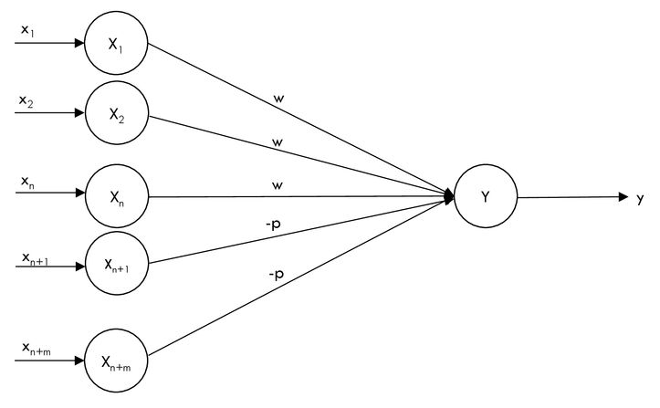
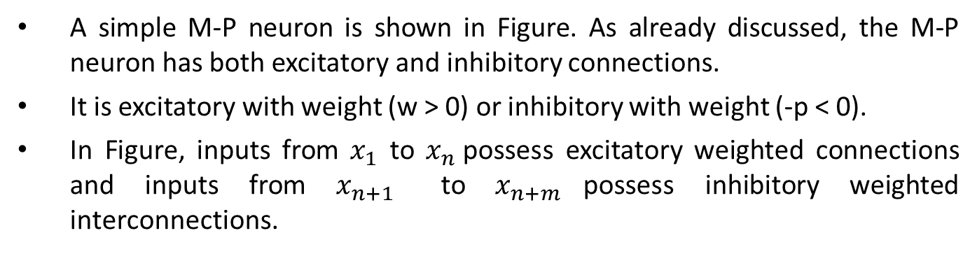
McCulloch-Pitts Neuron architecture
A simple M-P neuron is shown in Figure. As already discussed, the M-P neuron has both excitatory and inhibitory connections.
It is excitatory with weight (w > 0) or inhibitory with weight (-p < 0).
In Figure, inputs from $x_{1}$ to $x_{n}$possess excitatory weighted connections and inputs from $x_{n+1}$ to $x_{n+m}$possess inhibitory weighted interconnections.

Slide 41
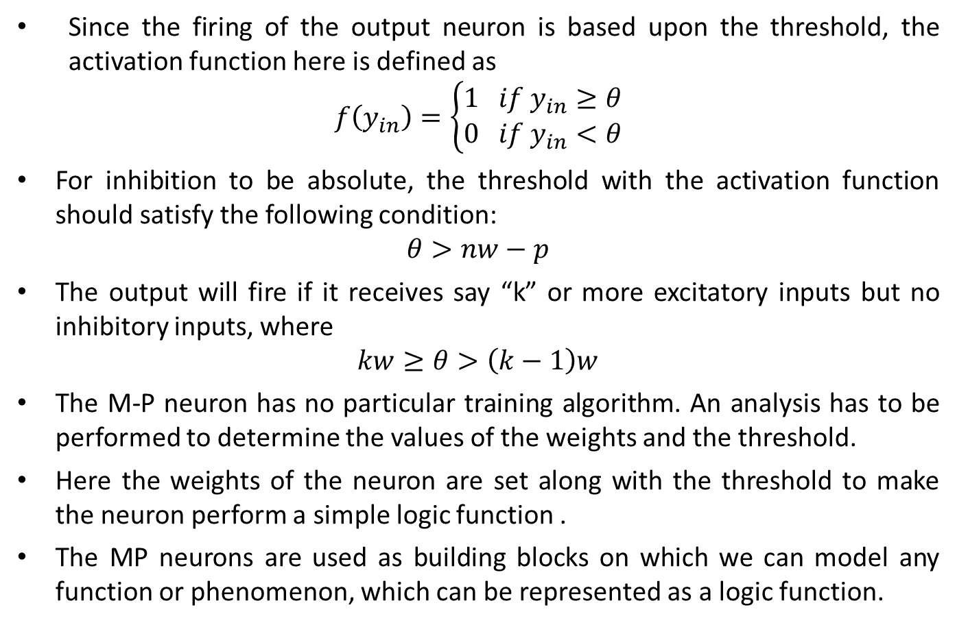
McCulloch-Pitts Neuron architecture
Since the firing of the output neuron is based upon the threshold, the activation function here is defined as
$$f\left(y_{in}\right)=\left\{\begin{matrix}1 if y_{in}≥θ \\ 0 if y_{in}<θ\end{matrix}\right.$$
For inhibition to be absolute, the threshold with the activation function should satisfy the following condition:
$$θ>nw−p$$
The output will fire if it receives say “k” or more excitatory inputs but no inhibitory inputs, where
$$kw≥θ>\left(k−1\right)w$$
The M-P neuron has no particular training algorithm. An analysis has to be performed to determine the values of the weights and the threshold.
Here the weights of the neuron are set along with the threshold to make the neuron perform a simple logic function .
The MP neurons are used as building blocks on which we can model any function or phenomenon, which can be represented as a logic function.

Slide 42
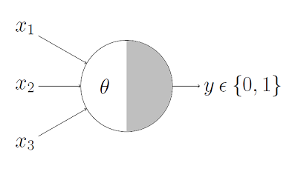
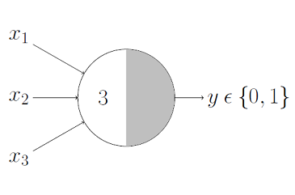
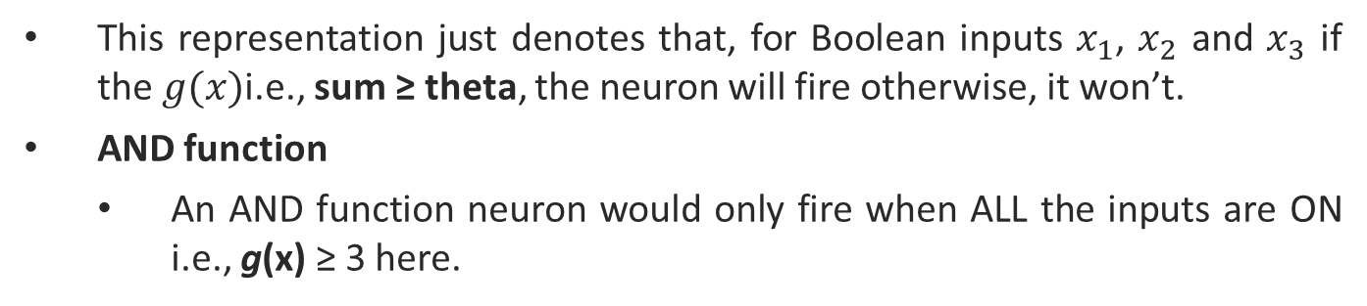
M-P Neuron : A Concise Representation
This representation just denotes that, for Boolean inputs $x_{1}$, $x_{2}$ and $x_{3}$ if the $g(x)$i.e., sum ≥ theta, the neuron will fire otherwise, it won’t.
AND function
An AND function neuron would only fire when ALL the inputs are ON i.e., g(x) ≥ 3 here.

Slide 43

M-P Neuron : A Concise Representation
OR function
An OR function neuron would fire if ANY of the inputs is ON i.e., g(x) ≥ 1 here..

Slide 44
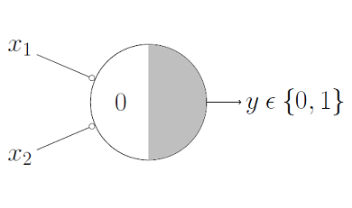
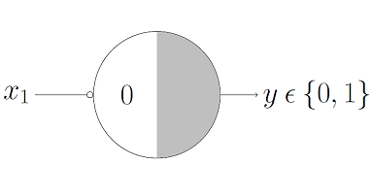
A function With An Inhibitory Input
NOR Function
For a NOR neuron to fire, we want ALL the inputs to be 0 so the thresholding parameter should also be 0 and we take them all as inhibitory input.
NOT Function
For a NOT neuron, 1 outputs 0 and 0 outputs 1. So we take the input as an inhibitory input and set the thresholding parameter to 0. It works!

Slide 45
Example

Slide 46
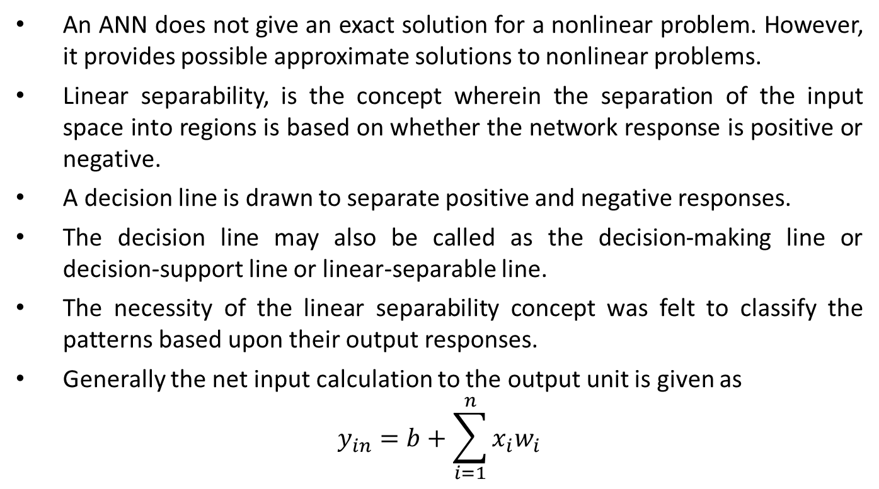
Linear Separability
An ANN does not give an exact solution for a nonlinear problem. However, it provides possible approximate solutions to nonlinear problems.
Linear separability, is the concept wherein the separation of the input space into regions is based on whether the network response is positive or negative.
A decision line is drawn to separate positive and negative responses.
The decision line may also be called as the decision-making line or decision-support line or linear-separable line.
The necessity of the linear separability concept was felt to classify the patterns based upon their output responses.
Generally the net input calculation to the output unit is given as
$$y_{in}=b+\sum_{i=1}^{n}{x_{i}w_{i}}$$

Slide 47
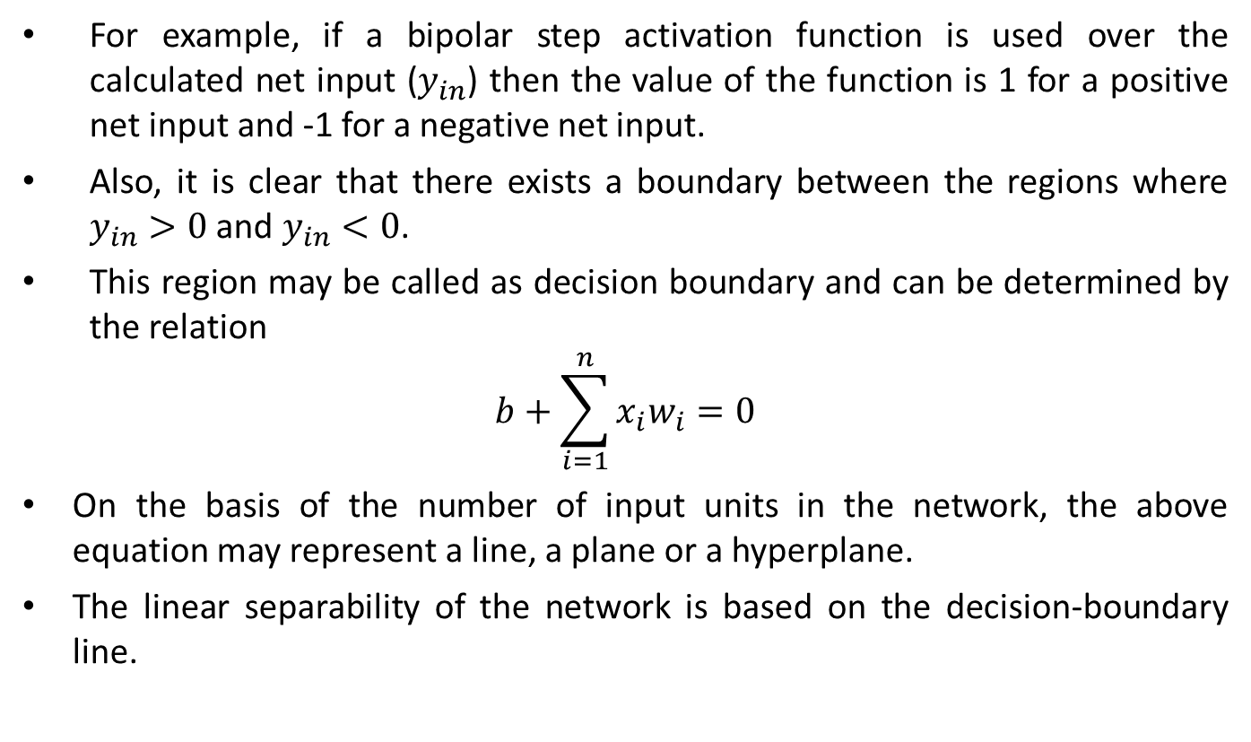
Linear Separability
For example, if a bipolar step activation function is used over the calculated net input ($y_{in}$) then the value of the function is 1 for a positive net input and -1 for a negative net input.
Also, it is clear that there exists a boundary between the regions where $y_{in}>0$ and $y_{in}<0$.
This region may be called as decision boundary and can be determined by the relation
$$b+\sum_{i=1}^{n}{x_{i}w_{i}}=0$$
On the basis of the number of input units in the network, the above equation may represent a line, a plane or a hyperplane.
The linear separability of the network is based on the decision-boundary line.

Slide 49
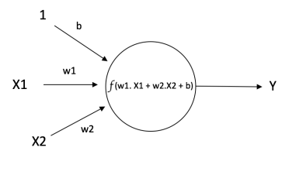
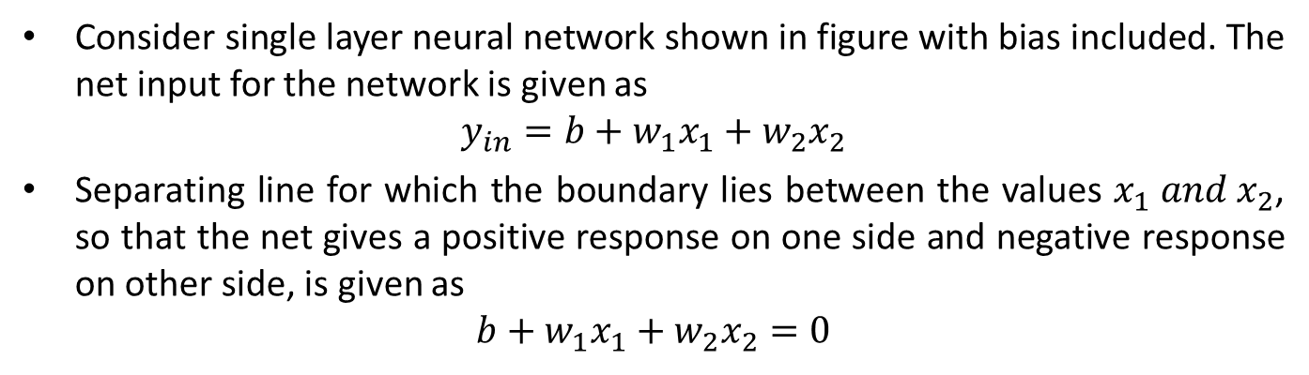
Linear Separability
If there exist weights (with bias) for which the training input vectors having positive (correct) response, +1, lie on one side of the decision boundary and all the other vectors having negative (incorrect) response, -1, lie on the other side of the decision boundary then we can conclude the problem is "linearly separable.“
Consider single layer neural network shown in figure with bias included. The net input for the network is given as
$$y_{in}=b+w_{1}x_{1}+w_{2}x_{2}$$
Separating line for which the boundary lies between the values $x_{1} and x_{2}$, so that the net gives a positive response on one side and negative response on other side, is given as
$$b+w_{1}x_{1}+w_{2}x_{2}=0$$

Slide 50
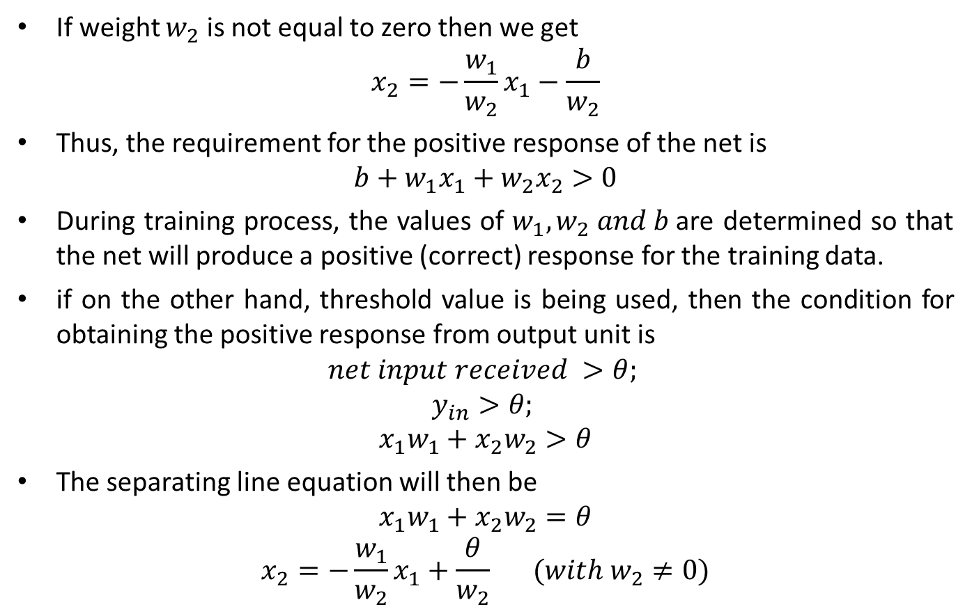
Linear Separability
If weight $w_{2}$ is not equal to zero then we get
$$x_{2}=−\frac{w_{1}}{w_{2}}x_{1}−\frac{b}{w_{2}}$$
Thus, the requirement for the positive response of the net is
$$b+w_{1}x_{1}+w_{2}x_{2}>0$$
During training process, the values of $w_{1}, w_{2} and b$are determined so that the net will produce a positive (correct) response for the training data.
if on the other hand, threshold value is being used, then the condition­ for obtaining the positive response from output unit is
$$net input received >θ;$$
$$y_{in}>θ;$$
$$x_{1}w_{1}+x_{2}w_{2}>θ$$
The separating line equation will then be
$$x_{1}w_{1}+x_{2}w_{2}=θ$$
$$x_{2}=−\frac{w_{1}}{w_{2}}x_{1}+\frac{θ}{w_{2}} (with w_{2}≠0)$$

Slide 51
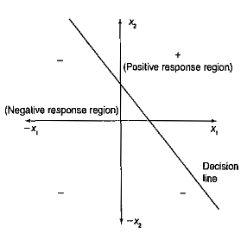
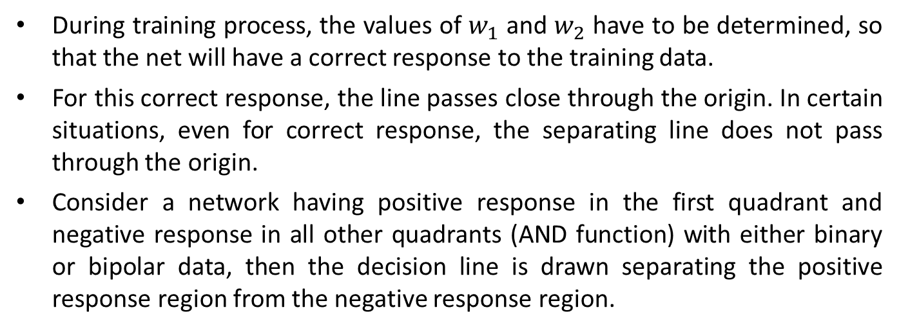
Linear Separability
During training process, the values of $w_{1}$ and $w_{2}$ have to be determined, so that the net will have a correct response to the training data.
For this correct response, the line passes close through the origin. In certain situations, even for correct response, the separating line does not pass through the origin.
Consider a network having positive response in the first quadrant and negative response in all other quadrants (AND function) with either binary or bipolar data, then the decision line is drawn separating the positive response region from the negative response region.
However, the data representation mode has to be decided - whether it would be in binary form or in bipolar form. It may be noted that the bipolar representation is better than the binary representation.

Slide 54
Neural Processing
The material of the previous section has focused mainly on the computation of response output (O) for a given input (x) for several important classes of neural networks.
The process of computation of o for a given x performed by the network is known as recall. Recall is the proper processing phase for a neural network, and its objective is to retrieve the information.
Recall corresponds to the decoding of the stored content which may have been encoded in a network previously.
In this section we are mainly concerned with the recall mode and the tasks it can accomplish.
Based on the preliminary observations made so far, we now outline the basic forms of neural information processing.

Slide 55
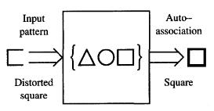
Neural Processing
Assume that a set of patterns can be stored in the network.
Later, if the network is presented with a pattern similar to a member of the stored set, it may associate the input with the closest stored pattern.
The process is called auto-association.
Typically, a degraded input pattern serves as a cue for retrieval of its original form.
This is illustrated schematically in Figure. The figure shows a distorted square recalling the square encoded.

Slide 56
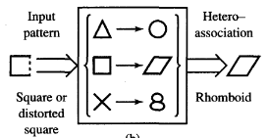
Neural Processing
Associations of input patterns can also be stored in a hetero-association variant.
In hetero associative processing, the associations between pairs of patterns are stored. This is schematically shown in Figure.
A square input pattern presented at the input results in the rhomboid at the output.
It can be inferred that the rhomboid and square constitute one pair of stored patterns.
A distorted input pattern may also cause correct hetero association at the output as shown with dashed line.

Slide 57
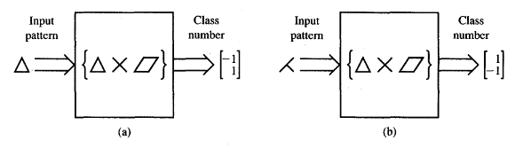
Neural Processing
Classification is another form of neural computation. Let us assume that a set of input patterns is divided into a number of classes, or categories.
In response to an input pattern from the set, the classifier is supposed to recall the information regarding class membership of the input pattern.
Typically, classes are expressed by discrete-valued output vectors, and thus output neurons of classifiers would employ binary activation functions.
The schematic diagram illustrating the classification response for patterns belonging to three classes is shown in Figure.

Slide 58
Neural Processing
Interestingly, classification can be understood as a special case of hetero-association.
The association is now between the input pattern and the second member of the hetero-associative pair, which is supposed to indicate the input's class number.
If the network's desired response is the class number but the input pattern does not exactly correspond to any of the patterns in the set, the processing is called recognition.
When a class membership for one of the patterns in the set is recalled, recognition becomes identical to classification.
Recognition within the set of three patterns is schematically shown in Figure.
This form of processing is of particular significance when an amount of noise is superimposed on input patterns.

Slide 59
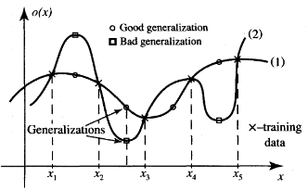
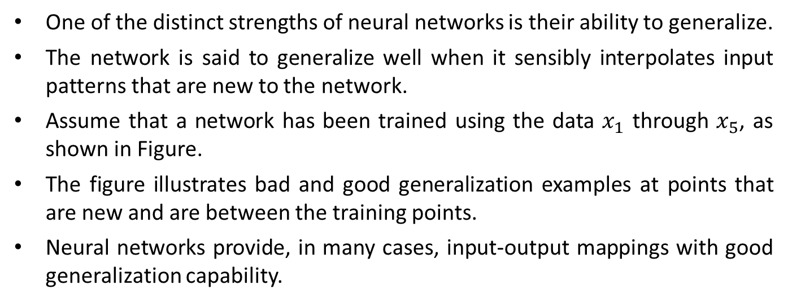
Neural Processing
One of the distinct strengths of neural networks is their ability to generalize.
The network is said to generalize well when it sensibly interpolates input patterns that are new to the network.
Assume that a network has been trained using the data $x_{1}$ through $x_{5}$, as shown in Figure.
The figure illustrates bad and good generalization examples at points that are new and are between the training points.
Neural networks provide, in many cases, input-output mappings with good generalization capability.

Slide 60


NEURAL NETWORK LEARNING RULES
A neuron is considered to be an adaptive element. Its weights are modifiable depending on the input signal it receives, its output value, and the associated teacher response.
In some cases the teacher signal is not available and no error information can be used, thus the neuron will modify its weights based only on the input and/or output. This is the case for unsupervised learning.
Let us study the learning of the weight vector $w_{i}$, or its components $w_{ij}$ connecting the $j^{th}$ input with the $i^{th}$ neuron.

Slide 62

NEURAL NETWORK LEARNING RULES
The trained network is shown in Figure.
In general, the $j^{th}$ input can be an output of another neuron or it can be an external input.
Our discussion in this section will cover single-neuron and single-layer network supervised learning and simple cases of unsupervised learning.
Under different learning rules, the form of the neuron's activation function may be different.
Note that the threshold parameter may be included in learning as one of the weights.
This would require fixing one of the inputs, say $x_{n}$. We will assume here that $x_{n}$, if fixed, takes the value of - 1.

Slide 63

NEURAL NETWORK LEARNING RULES
The following general learning rule is adopted in neural network studies (Amari 1990): The weight vector $w_{i} = [ w_{i1} w_{i2}$…… $w_{in}$]’ increases in proportion to the product of input x and learning signal r.
The learning signal r is in general a function of $w_{i},x,$ and sometimes of the teacher's signal $d_{i}$.
We thus have for the network shown in Figure
$$r=r(w_{i},x,d_{i})$$
The increment of the weight vector $w_{i}$ produced by the learning step at time t according to the general learning rule is
$$∆w_{i}\left(t\right)=cr\left[w_{i}\left(t\right),x\left(t\right),d_{i}\left(t\right)\right]x(t)$$
where c is a positive number called the learning constant that determines the rate of learning.

Slide 64

NEURAL NETWORK LEARNING RULES
The weight vector adapted at time t becomes at the next instant, or learning step,
$$w_{i}\left(t+1\right)=w_{i}\left(t\right)+cr\left[w_{i}\left(t\right),x\left(t\right),d_{i}\left(t\right)\right]x(t)$$
The superscript convention will be used in this text to index the discrete-time training steps as in above Eq.
For the $k^{th}$ step we thus have from using this convention
$$w_{i}^{k+1}=w_{i}^{k}+cr(w_{i}^{k},x^{k},d_{i}^{k})x^{k}$$
The learning in above equation assumes the form of a sequence of discrete-time weight modifications. Continuous-time learning can be expressed as
$$\frac{dw_{i}(t)}{dt}=crx(t)$$

Slide 65

Hebbian Learning Rule
For the Hebbian learning rule the learning signal is equal simply to the neuron's output (Hebb 1949). We have
$$r≅f(w_{i}^{′}x)$$
The increment $∆w_{i}$ of the weight vector becomes
$$∆w_{i}=cf\left(w_{i}^{′}x\right)x$$
The signal weight $w_{ij}$ is adapted using the following increment:
$$∆w_{ij}=cf\left(w_{i}^{′}x\right)x_{j}$$
This can be written briefly as
$$∆w_{ij}=c{o_{i}x}_{j} for j=1, 2,….,n$$
This learning rule requires the weight initialization at small random values around $w_{i}=0$ prior to learning.
The Hebbian learning rule represents a purely feedforward, unsupervised learning.

Slide 66

Hebbian Learning Rule
The rule implements the interpretation of the classic statement: "When an axon of cell A is near enough to excite a cell B and repeatedly or persistently takes place in firing it, some growth process or metabolic change takes place in one or both cells such that A's efficiency, as one of the cells firing B, is increased." (Hebb 1949.)
The rule states that if the cross product of output and input, or correlation term $o_{i}x_{j}$ is positive, this results in an increase of weight $w_{ij}$; otherwise the weight decreases.
It can be seen that the output is strengthened in turn for each input presented.
Therefore, frequent input patterns will have most influence at the neuron's weight vector and will eventually produce the largest output.
Since its inception, the Hebbian rule has evolved in a number of directions.
In some cases, the Hebbian rule needs to be modified to counteract unconstrained growth of weight values, which takes place when excitations and responses consistently agree in sign. This corresponds to the Hebbian learning rule with saturation of the weights at a certain, preset level.

Slide 67


Hebbian Learning Rule: Example
This example illustrates Hebbian learning with binary and continuous activation. functions of a very simple network. Assume the network shown in Figure with the initial weight vector needs to be trained using the set of three input vectors as below
$$x1=\begin{matrix}\begin{matrix}1 \\ −2\end{matrix} \\ \begin{matrix}1.5 \\ 0\end{matrix}\end{matrix} x2=\begin{matrix}\begin{matrix}1 \\ −0.5\end{matrix} \\ \begin{matrix}−2 \\ −1.5\end{matrix}\end{matrix} x3=\begin{matrix}\begin{matrix}0 \\ 1\end{matrix} \\ \begin{matrix}−1 \\ 1.5\end{matrix}\end{matrix}$$
for an arbitrary choice of learning constant c = 1. Since the initial weights are of nonzero value, the network has apparently been trained before hand.
Assume first that bipolar binary neurons are used, and thus f(net) = sgn (net).

Slide 70

Hebbian Learning Rule: Example
Step 1: Input x1 applied to the network results in activation ${net}^{1}$ as below:
$${net}^{1}=w^{1t}x_{1}=\left[\begin{matrix}\begin{matrix}1 & −1\end{matrix} & \begin{matrix}0 & 0.5\end{matrix}\end{matrix}\right]\left[\begin{matrix}\begin{matrix}1 \\ −2\end{matrix} \\ \begin{matrix}1.5 \\ 0\end{matrix}\end{matrix}\right]=3$$
The updated weights are
$$w^{2}=w^{1}+\operatorname{sgn}\left({net}^{1}\right)x_{1}=w^{1}+x_{1}=\left[\begin{matrix}\begin{matrix}1 \\ −1\end{matrix} \\ \begin{matrix}0 \\ 0.5\end{matrix}\end{matrix}\right]+\left[\begin{matrix}\begin{matrix}1 \\ −2\end{matrix} \\ \begin{matrix}1.5 \\ 0\end{matrix}\end{matrix}\right]=\left[\begin{matrix}\begin{matrix}2 \\ −3\end{matrix} \\ \begin{matrix}1.5 \\ 0.5\end{matrix}\end{matrix}\right]$$
Step 2: this learning step is with x2 as input:
$${net}^{2}=w^{2t}x_{2}=\left[\begin{matrix}\begin{matrix}2 & −3\end{matrix} & \begin{matrix}1.5 & 0.5\end{matrix}\end{matrix}\right]\left[\begin{matrix}\begin{matrix}1 \\ −0.5\end{matrix} \\ \begin{matrix}−2 \\ −1.5\end{matrix}\end{matrix}\right]=−0.25$$
The updated weights are
$$w^{3}=w^{2}+\operatorname{sgn}\left({net}^{2}\right)x_{2}=w^{2}−x_{2}=\left[\begin{matrix}\begin{matrix}2 \\ −3\end{matrix} \\ \begin{matrix}1.5 \\ 0.5\end{matrix}\end{matrix}\right]−\left[\begin{matrix}\begin{matrix}1 \\ −0.5\end{matrix} \\ \begin{matrix}−2 \\ −1.5\end{matrix}\end{matrix}\right]=\left[\begin{matrix}\begin{matrix}1 \\ −2.5\end{matrix} \\ \begin{matrix}3.5 \\ 2\end{matrix}\end{matrix}\right]$$

Slide 71

Hebbian Learning Rule: Example
Step 3: for Input x3, we obtain in this step:
$${net}^{3}=w^{3t}x_{3}=\left[\begin{matrix}\begin{matrix}1 & −2.5\end{matrix} & \begin{matrix}3.5 & 2\end{matrix}\end{matrix}\right]\left[\begin{matrix}\begin{matrix}0 \\ 1\end{matrix} \\ \begin{matrix}−1 \\ 1.5\end{matrix}\end{matrix}\right]=−3$$
The updated weights are
$$w^{4}=w^{3}+\operatorname{sgn}\left({net}^{3}\right)x_{3}=w^{3}−x_{3}=\left[\begin{matrix}\begin{matrix}1 \\ −2.5\end{matrix} \\ \begin{matrix}3.5 \\ 2\end{matrix}\end{matrix}\right]−\left[\begin{matrix}\begin{matrix}0 \\ 1\end{matrix} \\ \begin{matrix}−1 \\ 1.5\end{matrix}\end{matrix}\right]=\left[\begin{matrix}\begin{matrix}1 \\ −3.5\end{matrix} \\ \begin{matrix}4.5 \\ 0.5\end{matrix}\end{matrix}\right]$$
It can be seen that learning with discrete f(net) and c = 1 results in adding or subtracting the entire input pattern vectors to and from the weight vector, respectively.
In the case of a continuous f(net), the weight incrementing/decrementing vector is scaled down to a fractional value of the input pattern.

Slide 72

Hebbian Learning Rule: Example
Revisiting the Hebbian learning example, with continuous bipolar activation function f(net), using input x1 and initial weights $w^{1}$, we obtain neuron output values and the updated weights for $λ$ = 1 as summarized in Step 1.
The only difference compared with the previous case is that instead of f(net) = sgn (net), now the neuron's response is computed using bipolar sigmoid activation function.
Step 1:
$$f\left({net}^{1}\right)=\frac{2}{1+e^{−λ{net}^{1}}}−1=0.905;$$
$$w^{2}=w^{1}+f\left({net}^{1}\right)x_{1}=\left[\begin{matrix}\begin{matrix}1 \\ −1\end{matrix} \\ \begin{matrix}0 \\ 0.5\end{matrix}\end{matrix}\right]+0.905∗\left[\begin{matrix}\begin{matrix}1 \\ −2\end{matrix} \\ \begin{matrix}1.5 \\ 0\end{matrix}\end{matrix}\right]=\left[\begin{matrix}\begin{matrix}1.905 \\ −2.81\end{matrix} \\ \begin{matrix}1.357 \\ 0.5\end{matrix}\end{matrix}\right]$$
Step 2:
$$f\left({net}^{2}\right)=−0.077$$
$$w^{3}=\left[\begin{matrix}\begin{matrix}1.828 \\ −2.772\end{matrix} \\ \begin{matrix}1.512 \\ 0.616\end{matrix}\end{matrix}\right]$$

Slide 73

Hebbian Learning Rule: Example
Step 3:
$$f\left({net}^{3}\right)=−0.932$$
$$w^{4}=\left[\begin{matrix}\begin{matrix}1.828 \\ −3.70\end{matrix} \\ \begin{matrix}2.44 \\ −0.783\end{matrix}\end{matrix}\right]$$
Comparison of learning using discrete and continuous activation functions indicates that the weight adjustments are tapered for continuous f(net) but are generally in the same direction.

Slide 74

Perceptron Learning Rule
For the perceptron learning rule, the learning signal is the difference between the desired and actual neuron's response (Rosenblatt 1958).
Thus, learning is supervised and the learning signal is equal to
$$r≅d_{i}−o_{i}$$
where $o_{i}=sgn⁡(w_{i}^{t}x)$ and $d_{i}$ is the desired response. Weight adjustments in this method, $∆w_{i} and ∆w_{ij}$, are obtained as follows
$$∆w_{i}=c\left[d_{i}−\operatorname{sgn}\left(w_{i}^{t}x\right)\right]x$$
$$∆w_{ij}=c\left[d_{i}−\operatorname{sgn}\left(w_{i}^{t}x\right)\right]x_{j}, for j=1, 2, …., n$$
Note that this rule is applicable only for binary neuron response, and the relationships above express the rule for the bipolar binary case.
Under this rule, weights are adjusted if and only if $o_{i}$ is incorrect.
Error as a necessary condition of learning is inherently included in this training rule. Obviously, since the desired response is either 1 or - 1, the weight adjustment reduces to
$$∆w_{i}=±2cx$$

Slide 75


Perceptron Learning Rule
where a plus sign is applicable when $d_{i}=1$, and $sgn⁡(w^{t}x) = − 1$, and a minus sign is applicable when $d_{i}=−1$, and $sgn⁡(w^{t}x) = 1$.
The reader should notice that the weight adjustment formula (2.35) cannot be used when $d_{i}=sgn⁡(w^{t}x)$.
The weight adjustment is inherently zero when the desired and actual responses agree.
As we will see throughout this text, the perceptron learning rule is of central importance for supervised learning of neural networks.
The weights are initialized at any values in this method.

Slide 76

Perceptron Learning Rule: Example
The set of input training vectors is as follows:
$$x_{1}=\left[\begin{matrix}\begin{matrix}1 \\ −2\end{matrix} \\ \begin{matrix}0 \\ −1\end{matrix}\end{matrix}\right],x_{2}=\left[\begin{matrix}\begin{matrix}0 \\ 1.5\end{matrix} \\ \begin{matrix}−0.5 \\ −1\end{matrix}\end{matrix}\right],x_{3}=\left[\begin{matrix}\begin{matrix}−1 \\ 1\end{matrix} \\ \begin{matrix}0.5 \\ −1\end{matrix}\end{matrix}\right]$$
and the initial weight vector $w^{1}$ is assumed identical to previous Example.
The learning constant is assumed to be c = 0.1. The teacher's desired responses for $x_{1}$, $x_{2}$, $x_{3}$ are $d_{1}=−1$, $d_{2}=−1$, and $d_{3}=1$, respectively.
The learning according to the perceptron learning rule progresses as follows.

Slide 77

Perceptron Learning Rule: Example
Solution:
Step 1: Input is $x_{1}$, desired output is $d_{1}$:
$${net}^{1}=w^{1t}x_{1}=\left[\begin{matrix}\begin{matrix}1 & −1\end{matrix} & \begin{matrix}0 & 0.5\end{matrix}\end{matrix}\right]\left[\begin{matrix}\begin{matrix}1 \\ −2\end{matrix} \\ \begin{matrix}0 \\ −1\end{matrix}\end{matrix}\right]=2.5$$
Correction in this step is necessary since $d_{1}≠sgn⁡(2.5)$. We thus obtain updated weight vector
$$w^{2}=w^{1}+0.1(−1−1)x_{1}$$
$$w^{2}=\left[\begin{matrix}\begin{matrix}1 \\ −1\end{matrix} \\ \begin{matrix}0 \\ 0.5\end{matrix}\end{matrix}\right]−0.2\left[\begin{matrix}\begin{matrix}1 \\ −2\end{matrix} \\ \begin{matrix}0 \\ −1\end{matrix}\end{matrix}\right]=\left[\begin{matrix}\begin{matrix}0.8 \\ −0.6\end{matrix} \\ \begin{matrix}0 \\ 0.7\end{matrix}\end{matrix}\right]$$

Slide 78

Perceptron Learning Rule: Example
Step 2: Input is $x_{2}$, desired output is $d_{2}.$For the present weight vector $w^{2}$ we compute the activation value ${net}^{2}$ as follows:
$${net}^{2}=w^{2t}x_{2}=\left[\begin{matrix}\begin{matrix}0.8 & −0.6\end{matrix} & \begin{matrix}0 & 0.7\end{matrix}\end{matrix}\right]\left[\begin{matrix}\begin{matrix}0 \\ 1.5\end{matrix} \\ \begin{matrix}−0.5 \\ −1\end{matrix}\end{matrix}\right]=−1.6$$
Correction is not performed in this step since $d_{2} = sgn⁡(− 1.6)$
Step 3: Input is $x_{3}$, desired output is $d_{3}.$For the present weight vector $w^{3}$ we compute the activation value ${net}^{3}$ as follows:
$${net}^{3}=w^{3t}x_{3}=\left[\begin{matrix}\begin{matrix}0.8 & −0.6\end{matrix} & \begin{matrix}0 & 0.7\end{matrix}\end{matrix}\right]\left[\begin{matrix}\begin{matrix}−1 \\ 1\end{matrix} \\ \begin{matrix}0.5 \\ −1\end{matrix}\end{matrix}\right]=−2.6$$

Slide 79

Perceptron Learning Rule: Example
Correction in this step is necessary since $d_{3}≠sgn⁡(−2.1)$. We thus obtain updated weight vector
$$w^{4}=w^{3}+0.1(1+1)x_{3}$$
$$w^{4}=\left[\begin{matrix}\begin{matrix}0.8 \\ −0.6\end{matrix} \\ \begin{matrix}0 \\ 0.7\end{matrix}\end{matrix}\right]+0.2\left[\begin{matrix}\begin{matrix}−1 \\ 1\end{matrix} \\ \begin{matrix}0.5 \\ −1\end{matrix}\end{matrix}\right]=\left[\begin{matrix}\begin{matrix}0.6 \\ −0.4\end{matrix} \\ \begin{matrix}0.1 \\ 0.5\end{matrix}\end{matrix}\right]$$
This terminates the sequence of learning steps unless the training set is recycled.
It is not a coincidence that the fourth component of $x_{1}$, $x_{2}$, and $x_{3}$ in this example is invariable and equal to - 1.
Perceptron learning requires fixing of one component of the input vector, although not necessarily at the - 1 level.

Slide 80

Delta Learning Rule
The delta learning rule is only valid for continuous activation functions and in the supervised training mode.
The learning signal for this rule is called delta and is defined as follows
$$r≅[d_{i}−f(w_{i}^{t}x)]f^{′}(w_{i}^{t}x)$$
The term $f^{′}(w_{i}^{t}x)$ is the derivative of the activation function $f(net)$ computed for $net=w_{i}^{t}x$.
This learning rule can be readily derived from the condition of least squared error between $o_{i}$ and $d_{i}$. Calculating the gradient vector with respect to $w_{i}$ of the squared error defined as
$$E≅\frac{1}{2}{(d_{i}−o_{i})}^{2}$$
which is equivalent to
$$E≅\frac{1}{2}{[d_{i}−f\left(w_{i}^{t}x\right)]}^{2}$$

Slide 81

Delta Learning Rule
We obtain the error gradient vector value
$$∇E=−\left(d_{i}−o_{i}\right)f^{′}\left(w_{i}^{t}x\right)x$$
The components of the gradient vector are
$$\frac{∂E}{∂w_{ij}}=−\left(d_{i}−o_{i}\right)f^{′}\left(w_{i}^{t}x\right)x_{j} for j=1, 2,….n$$
Since the minimization of the error requires the weight changes to be in the negative gradient direction, we take
$$∆w_{i}=−ηΔΕ$$
Where $η$ is a positive constant. We then writes
$$∆w_{i}=η\left(d_{i}−o_{i}\right)f^{′}\left({net}_{i}\right)x$$
or, for the single weight the adjustment becomes
$$∆w_{ij}=η\left(d_{i}−o_{i}\right)f^{′}\left({net}_{i}\right)x_{j} for j=1, 2,….n$$

Slide 82

Delta Learning Rule
Note that the weight adjustment is computed based on minimization of the squared error.
Considering the use of the general learning rule and plugging in the learning signal, the weight adjustment becomes
$$∆w_{i}=c\left(d_{i}−o_{i}\right)f^{′}\left({net}_{i}\right)x$$
Therefore, it can be seen that above is identical to previous, since c and $η$ have been assumed to be arbitrary constants. The weights are initialized at any values for this method of training.
The delta rule was introduced only recently for neural network training (McClelland and Rumelhart 1986).
This rule parallels the discrete perceptron training rule.
It also can be called the continuous perceptron training rule.
The delta learning rule can be generalized for multilayer networks.

Slide 83


Delta Learning Rule: Example
This example discusses the delta learning rule as applied to the network shown in Figure. The set of input training vectors is as follows:
$$x_{1}=\left[\begin{matrix}\begin{matrix}1 \\ −2\end{matrix} \\ \begin{matrix}0 \\ −1\end{matrix}\end{matrix}\right],x_{2}=\left[\begin{matrix}\begin{matrix}0 \\ 1.5\end{matrix} \\ \begin{matrix}−0.5 \\ −1\end{matrix}\end{matrix}\right],x_{3}=\left[\begin{matrix}\begin{matrix}−1 \\ 1\end{matrix} \\ \begin{matrix}0.5 \\ −1\end{matrix}\end{matrix}\right]$$
The teacher's desired responses for $x_{1}$, $x_{2}$, $x_{3}$ are $d_{1}=−1$, $d_{2}=−1$, and $d_{3}=1$, respectively. Weight vector $w^{1t}=\left[\begin{matrix}\begin{matrix}1 & −1\end{matrix} & \begin{matrix}0 & 0.5\end{matrix}\end{matrix}\right]$.

Slide 84

Delta Learning Rule: Example
The delta learning requires that the value $f^{′}(net)$ be computed in each step using equation
$$f^{′}\left(net\right)=\frac{1}{2}(1−o^{2})$$
valid for the bipolar continuous activation function.
The result is useful since it expresses the slope of the activation function through the neuron's output signal.
For the arbitrarily chosen learning constant c = 0.1, and $λ$ = 1 for the bipolar continuous activation function $f(net)$, the delta rule training can be summarized as follows.
Step 1: input is vector $x_{1}$, initial weight vector is $w^{1}$:
$${net}^{1}=w^{1t}x_{1}=2.5;$$
$$o^{1}=f\left({net}^{1}\right)=0.848;$$
$f^{′}\left({net}^{1}\right)=\frac{1}{2}\left[1−{\left(o^{1}\right)}^{2}\right]=0.140$
$$w^{2}=c\left(d_{1}−o^{1}\right)f^{′}\left({net}^{1}\right)x_{1}+w^{1}={[0.974 −0.948 0 0.526]}^{t}$$

Slide 85

Delta Learning Rule: Example
Step 2: input is vector $x_{2}$, initial weight vector is $w^{2}$:
$${net}^{2}=w^{2t}x_{2}=−1.948;$$
$$o^{2}=f\left({net}^{2}\right)=−0.75;$$
$f^{′}\left({net}^{2}\right)=\frac{1}{2}\left[1−{\left(o^{2}\right)}^{2}\right]=0.218$
$$w^{3}=c\left(d_{2}−o^{2}\right)f^{′}\left({net}^{2}\right)x_{2}+w^{2}={[0.974 −0.956 0.002 0.531]}^{t}$$
Step 3: input is vector $x_{3}$, initial weight vector is $w^{3}$:
$${net}^{3}=w^{3t}x_{3}=−2.46;$$
$$o^{3}=f\left({net}^{3}\right)=−0.842;$$
$f^{′}\left({net}^{3}\right)=\frac{1}{2}\left[1−{\left(o^{3}\right)}^{2}\right]=0.145$
$$w^{4}=c\left(d_{3}−o^{3}\right)f^{′}\left({net}^{3}\right)x_{3}+w^{3}={[0.947 −0.929 0.016 0.505]}^{t}$$
Obviously, since the desired values are $±1$ in this example, the corrections will be performed in each step, since $d_{i}−f({net}_{i})≠0$ throughout the entire training. This method usually requires small c values, since it is based on moving the weight vector in the weight space in the negative error gradient direction.

Slide 86

Widrow-Hoff Learning Rule
The Widrow-Hoff learning rule (Widrow 1962) is applicable for the supervised training of neural networks.
It is independent of the activation function of neurons used since it minimizes the squared error between the desired output value $d_{i}$ and the neuron's activation value ${net}_{i} = w_{i}^{t}x$. The learning signal for this rule is defined as follows
$$r≅d_{i}−w_{i}^{t}x$$
The weight vector increment under this learning rule is
$$∆w_{i}=c\left(d_{i}−w_{i}^{t}\right)x$$
or, for the single weight the adjustment is
$$∆w_{ij}=c\left(d_{i}−w_{i}^{t}\right)x_{j} for j=1,2,….n$$
This rule can be considered a special case of the delta learning rule. the activation function is simply the identity function $f (net) = net$, we obtain $f ′(net) = 1$. This rule is sometimes called the LMS (least mean square) learning rule. Weights are initialized at any values in this method.

Slide 87

Correlation Learning Rule
By substituting $r = d_{i}$into the general learning rule we obtain the correlation learning rule. The adjustments for the weight vector and the single weights, respectively, are
$$∆w_{i}=cd_{i}x$$
$$∆w_{ij}=cd_{i}x_{j} for j=1,2….n$$
This simple rule states that if $d_{i}$ is the desired response due to $x_{j}$, the corresponding weight increase is proportional to their product.
The rule typically applies to recording data in memory networks with binary response neurons.
It can be interpreted as a special case of the Hebbian rule with a binary activation function and for $o_{i}=d_{i}$
However, Hebbian learning is performed in an unsupervised environment, while correlation learning is supervised. While keeping this basic difference in mind we can observe that Hebbian rule weight adjustment becomes identical.
Similar to Heb-learning rule also requires the weight initialization w = 0.

Slide 88

Winner-Takes All Learning Rule
This learning rule differs substantially from any of the rules discussed so far.
It can only be demonstrated and explained for an ensemble of neurons, preferably arranged in a layer of p units.
This rule is an example of competitive learning , and it is used for unsupervised network training.
Typically, winner-take-all learning is used for learning statistical properties of inputs (Hecht-Nielsen 1987).
The learning is based on the premise that one of the neurons in the layer, say $m^{th}$, has the maximum response due to input x.
This neuron is declared the winner. As a result of this winning event, the weight vector $w_{m}$
$w_{m}={\left[w_{m1} w_{m2} …. w_{mn}\right]}^{t}$
containing weights highlighted in the figure is the only one adjusted in the given unsupervised learning step.

Slide 89


Winner-Takes All Learning Rule
Its increment is computed as follows
$$∆w_{m}=∝(x−w_{m})$$
or, the individual weight adjustment becomes
$$∆w_{mj}=∝\left(x_{j}−w_{mj}\right), for j=1,2,….n$$
Where $∝>0$ is small learning constant, typically decreasing as learning progresses.
The winner selection is based on the following criterion of Maximum activation among all p neurons participating in a competition:
$$w_{m}^{t}x=\max_{i=1,2,….p}{(w_{i}^{t}x)}$$

Slide 90

Winner-Takes All Learning Rule
This criterion corresponds to finding the weight vector that is closest to the input x.
The rule then reduces to incrementing $w_{m}$, by a fraction of $x −w_{m}$.
Note that only the winning neuron fan-in weight vector is adjusted.
After the adjustment, its fan-in weights tend to better estimate the input pattern in question.
In this method, the winning neighborhood is sometimes extended beyond the single neuron winner so that it includes the neighboring neurons.
Weights are typically initialized at random values and their lengths are normalized during learning in this method.

Slide 91

Outstar Learning Rule
Outstar learning rule is another learning rule that is best explained when neurons are arranged in a layer.
This rule is designed to produce a desired response d of the layer of p neurons shown in Figure (Grossberg 1974, 1982).

Slide 92

Outstar Learning Rule
The rule is used to provide learning of repetitive and characteristic properties of input /output relationships.
This rule is concerned with supervised learning; however, it is supposed to allow the network to extract statistical properties of the input and output signals.
The weight adjustments in this rule are computed as follows
$$∆w_{j}=β\left(d−w_{j}\right)$$
Or, the individual weight adjustment are
$∆w_{mj}=β\left(d_{m}−w_{mj}\right), for m=1,2,……p$
Note that in contrast to any learning rule discussed so far, the adjusted weights are fanning out of the $j′th$ node in this learning method and the weight vector is defined accordingly as
$w_{j}≅{\left[w_{1j} w_{2j}…..w_{pj}\right]}^{t}$
Arbitrarily selectable $β$ is a small positive learning constant decreasing during training. The rule typically ensures that the output pattern becomes similar to the undistorted desired output after repetitively applying equation on distorted output versions.

Slide 93

Summary of Learning Rules

Slide 94
Summary of Learning Rules
Table provides the summary of learning rules and of their properties.
Seven learning rules are tabulated and compared in terms of the single weight adjustment formulas, supervised versus unsupervised learning mode, weight initialization, and required neuron activation functions.
Also, reference is made in the table regarding the conditions of learning.
Most learning rules allow for learning of a single, isolated neuron's weight with exception of winner-take-all and outstar rules.
Both of these rules require a layer of neurons in order for the weight adaptation to proceed.
So far we have assumed that desired output values are precisely known for each input pattern when a network is trained in the supervised mode.
But in some situations fewer details are available. When only partial information is available about the correctness of the network's response, we have so-called reinforcement learning.

Slide 95
Summary of Learning Rules
In the extreme case, only "right" or "wrong" information is available to provide instruction to the network.
The amount of feedback received from the environment is very limited in such cases since the teacher's signal is rather evaluative than instructive.
The reinforcement learning is sometimes called "learning with a critic" as opposed to learning with a teacher (Hertz, Krogh, and Palmer 1991).
The coverage of the seven most important learning rules in this section is by no means exhaustive.
Only those rules that are used later in the text have been covered.
However, a serious reader may at this point raise a question about validity, convergence, or practical importance of the rules.
Fortunately, each of the learning rules has its meaning and its own mathematical substantiation and applicability.
Indeed, neural networks can be trained using these rules to perform useful tasks such as classification, recognition, or association.
The outcome of the training is as usual for any training: Results are for the most part successful, but failures are also sometimes possible; however, they are the exception, rather than the rule.
The exposition in later chapters provides more detailed answers to questions about why neural networks are capable of learning.
We will also study how the network learning assists in solving problems that otherwise would have been difficult to solve.

Slide 96

Problems for Practice
Problem 1: Four steps of Hebbian learning of single neuron network have been implemented starting with $w^{1}={\left[\begin{matrix}1 & −1\end{matrix}\right]}^{t}$ for learning constant c=1 using inputs as follows:
$$x_{1}=\left[\begin{matrix}1 \\ −2\end{matrix}\right], x_{2}=\left[\begin{matrix}0 \\ 1\end{matrix}\right], x_{3}=\left[\begin{matrix}2 \\ 3\end{matrix}\right],x_{4}=\left[\begin{matrix}1 \\ −1\end{matrix}\right]$$
find final weights for:
Bipolar binary $f(net)$
Bipolar continuous $f\left(net\right), λ=1$
Problem 2: Implement the perceptron rule of network using $f\left(net\right)=\operatorname{sgn}\left(net\right), c=1$ and the following data specifying the initial weights $w^{1}$, and the two training pairs
$$w^{1}=\left[\begin{matrix}0 \\ 1 \\ 0\end{matrix}\right], \left(x_{1}=\left[\begin{matrix}2 \\ 1 \\ −1\end{matrix}\right],d_{1}=−1 \right), \left(x_{2}=\left[\begin{matrix}0 \\ −1 \\ −1\end{matrix}\right],d_{2}=1 \right)$$
Repeat the training sequence $\left(x_{1},d_{1}\right)$, $\left(x_{2},d_{2}\right)$ until two correct responses in a row are achieved.

Slide 97

Problems for Practice
Problem 3: Perform two training steps of the network using the delta learning rule for $λ=1$ and $c = 0.25$. Train the network using the following data pairs
$$w^{1}=\left[\begin{matrix}1 \\ 0 \\ 1\end{matrix}\right], \left(x_{1}=\left[\begin{matrix}2 \\ 0 \\ −1\end{matrix}\right],d_{1}=−1 \right), \left(x_{2}=\left[\begin{matrix}1 \\ −2 \\ −1\end{matrix}\right],d_{2}=1 \right)$$
$$\left[Hint:Use f^{′}\left(net\right)=(1/2)(1−o^{2})\right]$$

